Slide 1
Important features for
Predicting an AirBnB’s rating
Ambar Pathak , Henry Hirsch, Nena Beecham, Robert Williams

Slide 2
01 - Introduction/Prior Knowledge
04 - Model Building
02 - Data Preprocessing
05 - Interpretation of Results
03 - Exploratory Data Analysis
Table of contents

Slide 3
Introduction
01

Slide 4
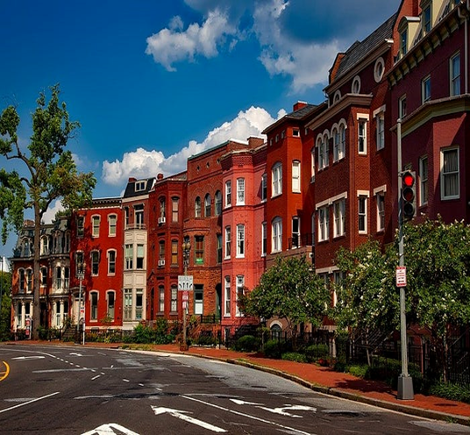
Prior Research/Analysis on AirBnB
In May 2020, Jessie Owens published an article titled "An Analysis of AirBnB in Washington, DC (Owens, 2020)."
Jessie claimed that she finds hotels to be just too impersonal and touristy when looking for lodging.
Therefore, she discovered and started using AirBnB, it piqued her curiosity greatly.
By avoiding the tourist and commercial portions of a city and staying in a local area, one might experience a place or area more like a native.
For travelers all around the world, it has become a well-liked
substitute for hostels, hotels, and resorts. She found the
motto "belong anywhere" by AirBnB to be enticing since she
wanted to experience travel like a native.

Slide 5

Prior Research/Analysis on AirBnB
The purpose of Jessie's effort was to uncover intriguing patterns in the data that could be instructive for a traveler, a homeowner (or host), an AirBnB decision-maker, or even a D.C. housing regulator.
Jessie came up with a couple of inquiries that she hoped to address with the information:
What connections may be drawn between AirBnB data and significant occurrences in the nation's capital over the previous 10 years?
What elements play a major role in pricing prediction?
According to Jessie, the following was the most crucial lesson discovered throughout this study and analytical project -
“Ask the right question. Make it as specific as possible.”

Slide 6
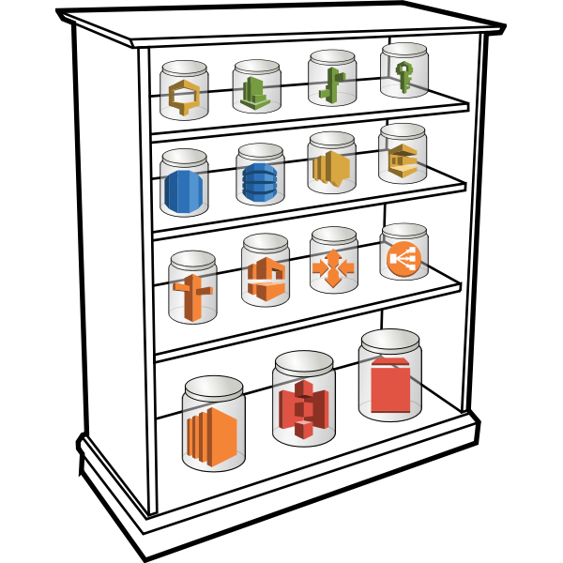
Information About the Data
InsideAirBnB.com provided the data that was used for this study.
Datasets for AirBnB information for cities across the world are kept on this website.
The site moderators update the datasets on a sporadic basis. Some of the data was gathered between 2013 and the present.
Our data dictionary file, listings.csv, has 6542 rows of data and 75 columns, including the id column (Inside Airbnb, 2023).
Numerous Fields (id, listing_url, scrape_id, neighborhood_overview, host_id, etc.), Types (integers, text, bigint, etc.), and
Descriptions may be found in the listing.csv file.

Slide 7

SMART Question and Project Overview
SMART Question:
What are the most important features for predicting an AirBnB’s rating in the city of Washington, DC from 2013 to 2023?
Through our research, we hope to gauge how a listing’s rating is influenced by a number of factors including the structural characteristics of the property, the location of the property, and the host’s behavior.
Through helping hosts figure out which factors help improve their ratings, they can develop more sought out listings and thus increase booking frequency and revenue

Slide 8

Some Stats for Washington DC AirBnB
Room Type
Activites
Listing per Host
Entire homes/apts - 75.9%
Entire homes/apts - 4,964 (75.9%)
Private rooms - 1,483 (22.7%)
Shared rooms - 80 (1.2%)
Hotel rooms - 14 (0.2%)
Average nights booked - 89
Price/night - $212
Average income - $15,458
Multi-listings - 58.7%
Single listings - 2,701 (41.3%)
Multi-listings - 3,840 (58.7%)

Slide 9
Final Columns in the DataFrame
host_response_time float64
host_response_rate float64
host_acceptance_rate float64
host_is_superhost float64
accommodates int64
bedrooms float64
beds float64
instant_bookable int64
price float64
Clothing int64 [Engineered]
Entertainment int64 [Engineered]
Exercise int64 [Engineered]
Kitchen int64 [Engineered]
Luxury int64 [Engineered]
Outdoor int64 [Engineered]
Parking int64 [Engineered]
Security int64 [Engineered]
Streaming int64 [Engineered]
Technology int64 [Engineered]
Views int64 [Engineered]
Ward int64 [Engineered]
Privacy int64 [Engineered]
Target int64 [Engineered]
dtype: object
Image Reference: https://images.app.goo.gl/KKNYKFAb3RqRfGKb8

Slide 10
Data Preprocessing
02

Slide 11
Data Preprocessing
1
2
3
Check for duplicates.
Check for null values.
Convert data types.

Slide 12
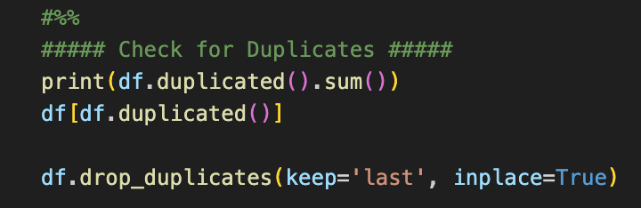
Data Preprocessing: Check for Duplicates
Check for total number of duplicates
Filter dataframe to see duplicate rows
Drop all duplicate rows except the last (most recent)

Slide 13
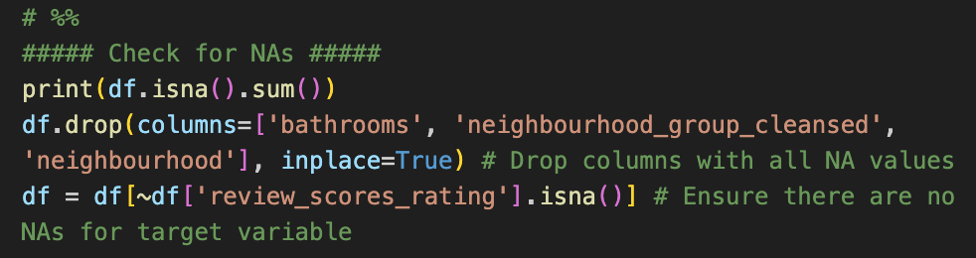
Data Preprocessing: Check for Null Values
Check for number of nulls by column
Drop columns with all nulls
Filter out rows with null values for the target variable

Slide 14
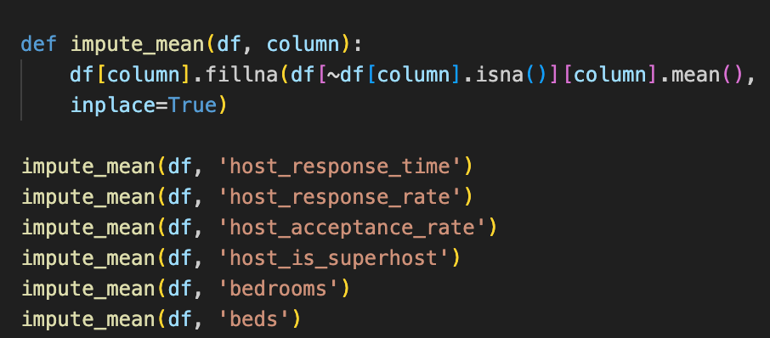
Data Preprocessing: Imputing Null Values
A function was developed to calculate the mean for numeric variables and replace null values with the mean
The function was then applied to numeric columns with null values

Slide 15
Feature Engineering: Amenities Variable
all_amenities = [x.lower() for x in all_amenities]
streaming = ['netflix', 'amazon prime video', 'hbo max', 'hulu', 'disney+', 'apple tv', 'chromecast', 'fire tv', 'premium cable']
outdoor = ['outdoor pool', 'grill', 'bbq grill', 'hot tub', 'fire pit', 'outdoor kitchen', 'kayak', 'outdoor dining area', 'patio or balcony', 'lake access', 'resort access', 'outdoor shower', 'waterfront', 'hammock', 'beach access']
view = ['canal view','vineyard view','river view','ocean view','beach view','valley view','mountain view','harbor view',
'pool view','bay view','resort view','sea view','golf course view','lake view','desert view','marina view', 'garden view','city skyline view','courtyard view', 'park view']
entertainment = ['game console', 'gaming console', 'ps3', 'ps4', 'ps5', 'xbox', 'hdtv', 'dvd player', 'nintendo wii', 'nintendo switch']
The Amenities column contains lists of amenities in each listing
There were over 2,000 unique amenities throughout the file
Amenity groups were developed to more easily identify what type of amenities a listing had.
The final groups were:
Streaming Services, Outdoor, Special Views, Entertainment, Kitchen Appliances, Other Appliances, Technology, Luxury, Security, Free Parking, and Exercise

Slide 16
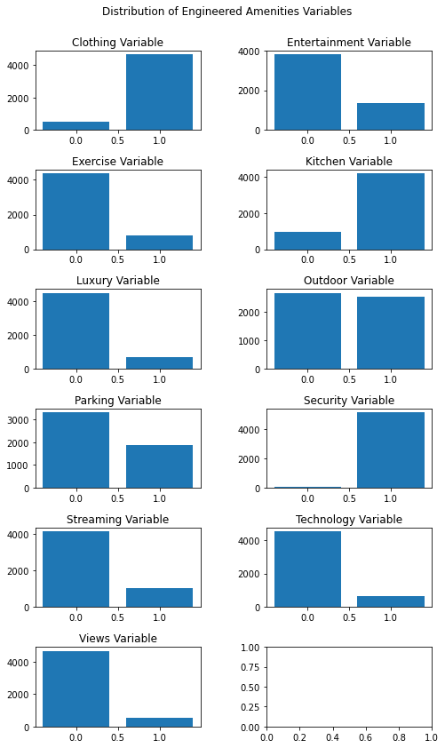
Feature Engineering: Final Amenities Variables

Slide 17
Feature Engineering: Neighborhoods Variable
for idx in df.index:
neighborhood_list = [x.strip() for x in df['neighbourhood_cleansed'][idx].split(',')]
if len(neighborhood_list) > 1:
if any(x.lower() in ward1 for x in neighborhood_list):
ward.append(1)
elif any(x.lower() in ward2 for x in neighborhood_list):
ward.append(2)
elif any(x.lower() in ward3 for x in neighborhood_list):
ward.append(3)
elif any(x.lower() in ward4 for x in neighborhood_list):
ward.append(4)
elif any(x.lower() in ward5 for x in neighborhood_list):
ward.append(5)
elif any(x.lower() in ward6 for x in neighborhood_list):
ward.append(6)
elif any(x.lower() in ward7 for x in neighborhood_list):
ward.append(7)
elif any(x.lower() in ward8 for x in neighborhood_list):
ward.append(8)
The Neighborhood column contains lists of neighborhoods each listing is part of
There were over 120 unique neighborhoods throughout the file
The neighborhoods were sorted into one of DC’s 8 wards to more easily define their location

Slide 18
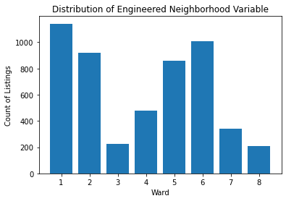
Feature Engineering: Final Neighborhoods Variables

Slide 19
Data Type Conversions
##### Convert Price to Float #####
prices = []
for price in df['price']:
if "," in price:
prices.append(float(''.join(price[1:].split(','))))
else:
prices.append(float(price[1:]))
df['price'] = prices
##### Convert Instant Bookable to Boolean Integer #####
df['instant_bookable'] = df['instant_bookable'].replace({'t':1, 'f':0})
##### Convert Room Type to Ordinal Variable #####
df['Privacy'] = df['room_type'].replace({'Entire home/apt':1, 'Private room':2, 'Shared room': 3, 'Hotel room':4})
Nearly all columns were listed as string/object data types.
Some columns were changed to ordinal numeric variables (ex. Room type), others were changed to boolean integers (ex. Instant bookable).
Some columns were already numeric but still needed to be processed to get rid of special characters (ex. Price, host response rate).

Slide 20
Exploratory Data Analysis
03

Slide 21
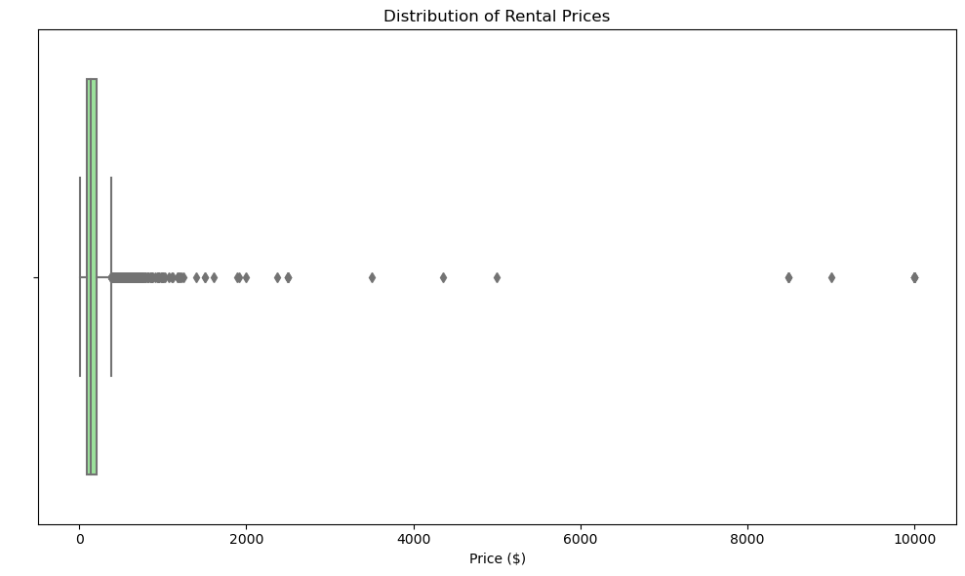
Rental Price Distribution is Right-Skewed

Slide 22
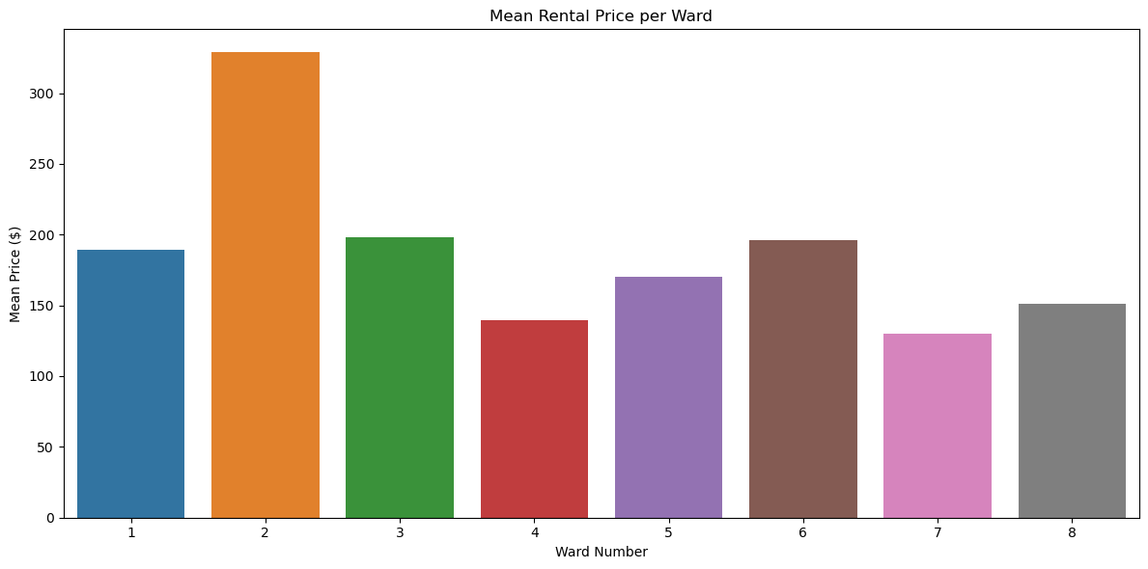
Mean Rental Price by Ward

Slide 23
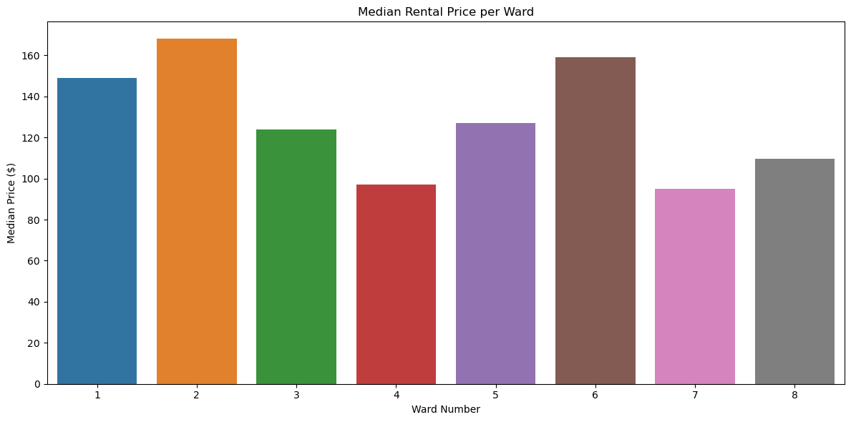
Median Rental Price by Ward

Slide 24
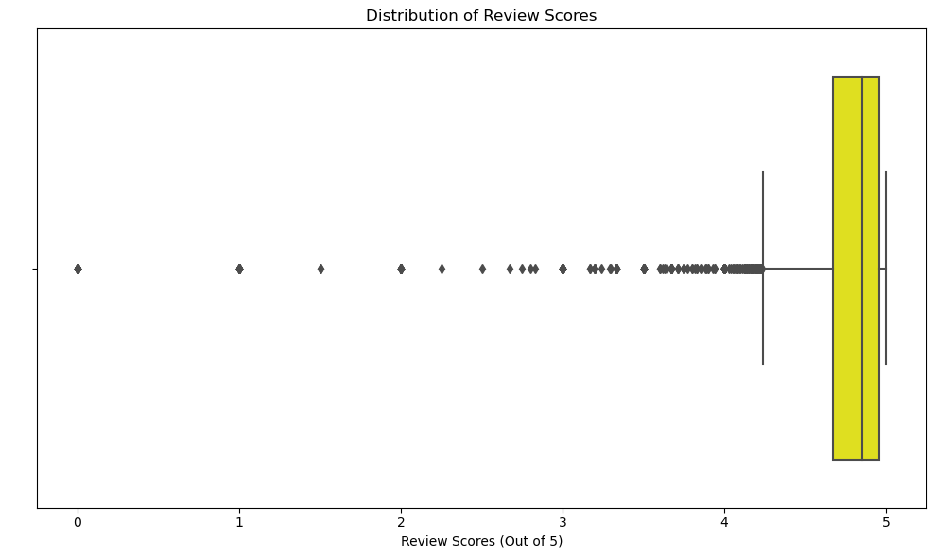
Review Score Distribution Has Little Variation

Slide 25
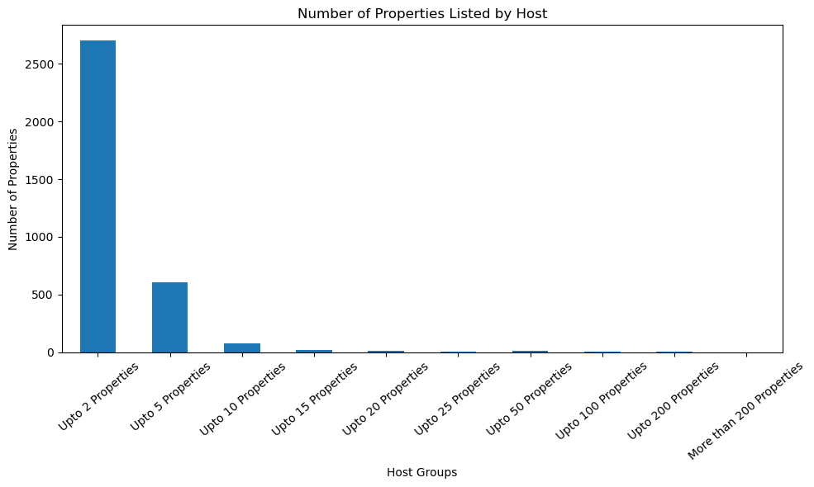
Property Listings Grouped by host

Slide 26
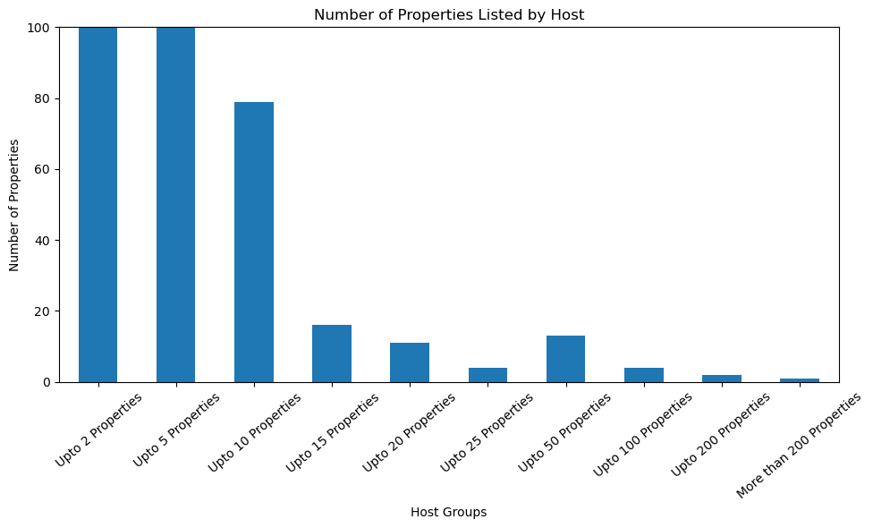
Property Listings Grouped by host

Slide 27
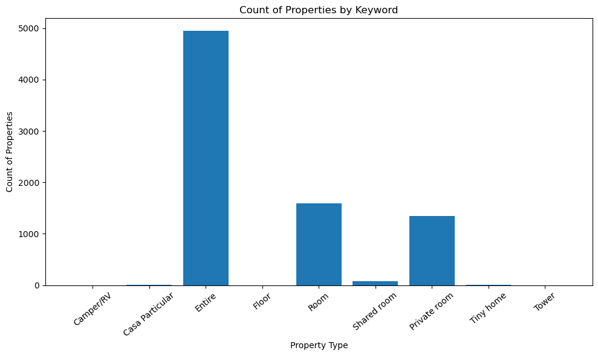
Property Count by Keyword

Slide 28
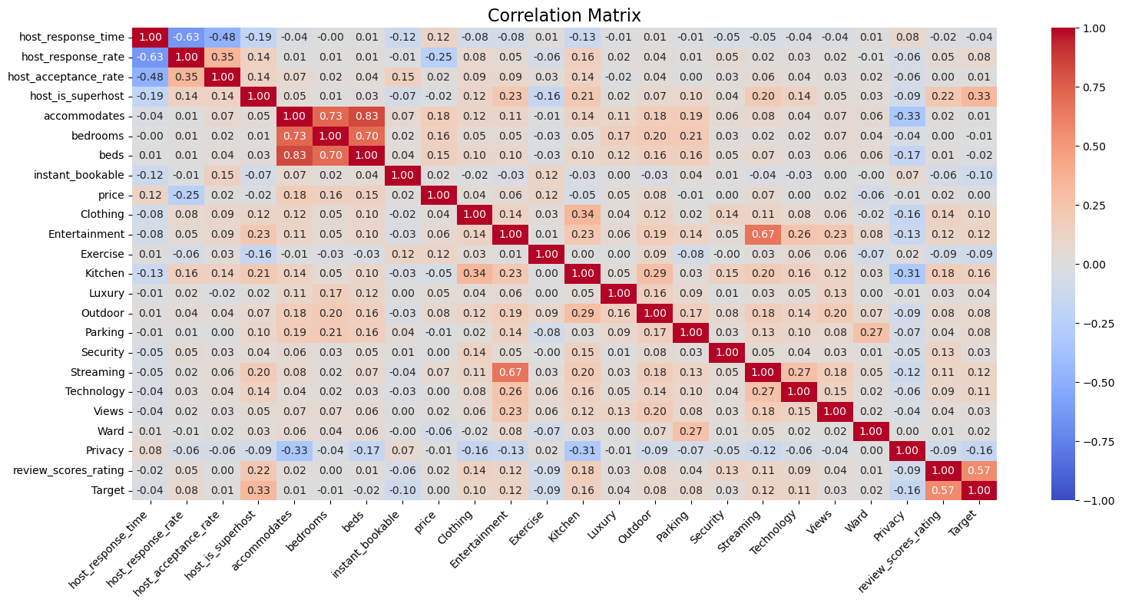
Correlation Matrix

Slide 29
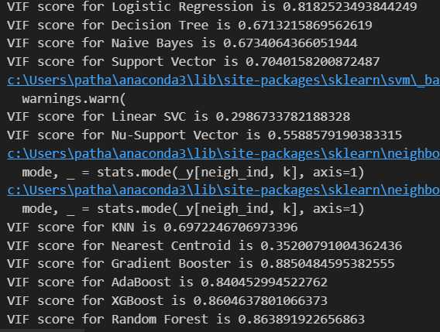
VIF values

Slide 30
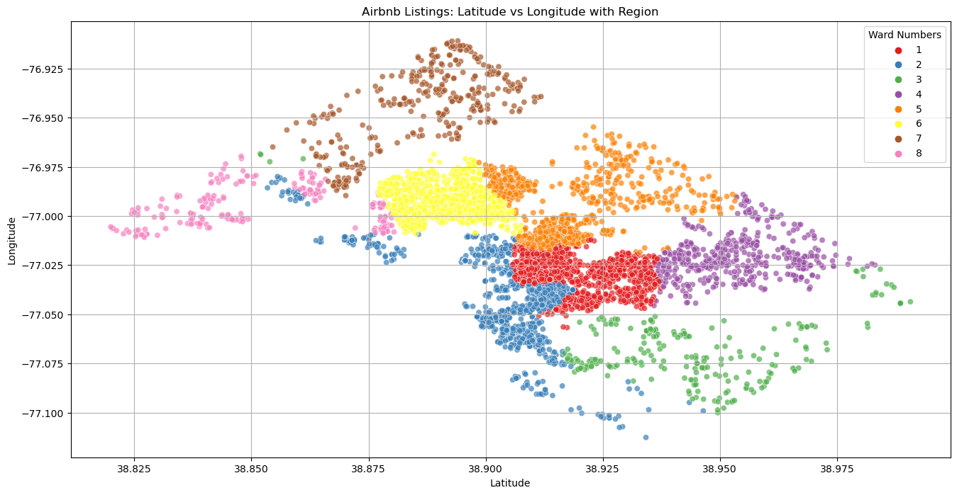
Scatter Plot : Geographical location based on wards

Slide 31
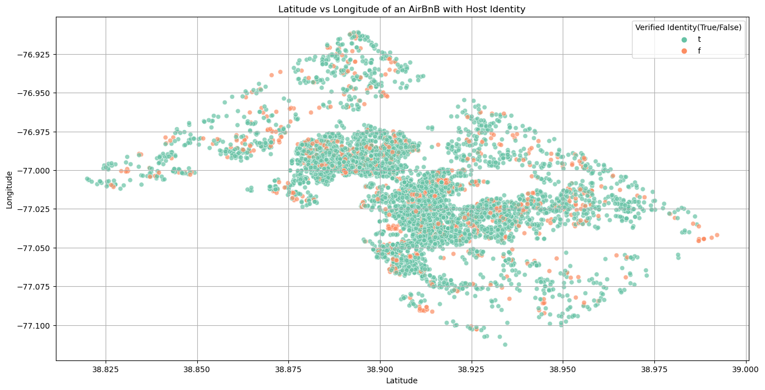
Scatter Plot : Verified Hosts

Slide 32
Model Building and Variable Importance
04

Slide 33
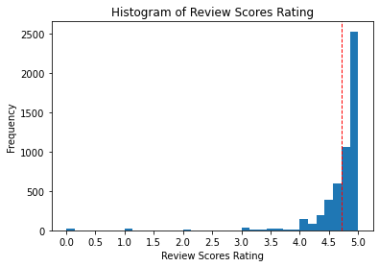
First Modeling Attempt: Regression
The review scores rating variable had very little variation, with a standard deviation of 0.50.
When attempting to predict review scores rating with regression models such as Linear Regression and Decision Tree Regressor, the models revealed very low r2 scores and high MSE scores

Slide 34
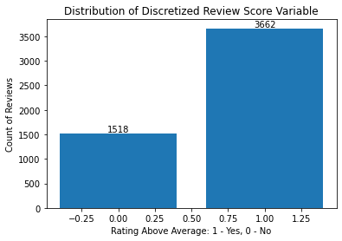
Second Modeling Attempt: Ratings Discretization and Classification
To remedy this, the review scores rating variable was changed to a binary target.
The classes are 1: rating is above the average rating and 2: rating is below the average rating.
As seen in the plot, there is a slight imbalance between the two classes, but not enough to make classification modeling impossible.

Slide 35
Model Selection: Best Performing Models
for name, model in models.items():
model.fit(x_train, y_train)
y_pred = model.predict(x_test)
cf_matrix = confusion_matrix(y_test, y_pred)
matrix_plot = ConfusionMatrixDisplay(cf_matrix)
matrix_plot.plot()
plt.suptitle(f'Confusion Matrix for {name}',y=1.05)
plt.title('Class 0: Below Average \n Class 1: Above Average')
Several models were tested, including K-Nearest Neighbors, Gradient Boost, XGBoost, Linear SVC, and ADA Boost.
Out of all models tested, the Decision Tree, Gradient Boost, and Naive Bayes models performed the best.
Both models were cross-validated to further assess their performance.

Slide 36
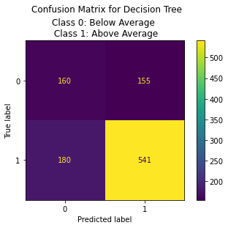
Decision Tree: Confusion Matrix and CV Results
Metric | Min | Mean | Median | Max | Stdv
balanced_accuracy | 0.519097 | 0.598229 | 0.586918 | 0.694444 | 0.048029
f1_score | 0.699301 | 0.752125 | 0.739437 | 0.797386 | 0.033906
precision | 0.704225 | 0.756418 | 0.751543 | 0.820896 | 0.030603
recall | 0.694444 | 0.748877 | 0.729167 | 0.847222 | 0.046998
npv | 0.333333 | 0.440733 | 0.412121 | 0.540541 | 0.068661
tnr | 0.34375 | 0.447581 | 0.435484 | 0.625 | 0.074112

Slide 37
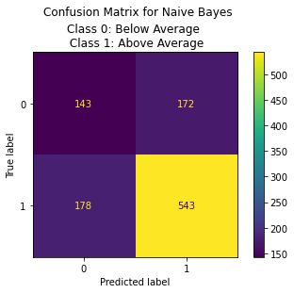
Naive Bayes: Confusion Matrix and CV Results
Metric | Min | Mean | Median | Max | Stdv
balanced_accuracy | 0.543011 | 0.62886 | 0.626176 | 0.773746 | 0.059855
f1_score | 0.691176 | 0.766494 | 0.776586 | 0.84058 | 0.042552
precision | 0.727273 | 0.776728 | 0.77033 | 0.878788 | 0.040125
recall | 0.643836 | 0.758828 | 0.770833 | 0.833333 | 0.06092
npv | 0.351351 | 0.478049 | 0.48433 | 0.621622 | 0.073836
tnr | 0.375 | 0.498891 | 0.483871 | 0.741935 | 0.101927

Slide 38
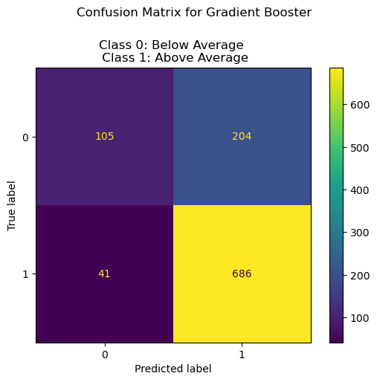
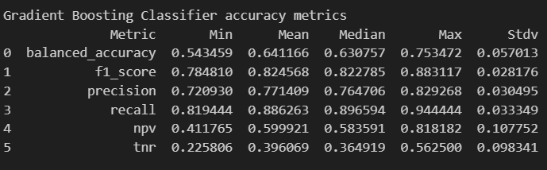
Gradient Boosting Classifier : Confusion Matrix and CV Results

Slide 39
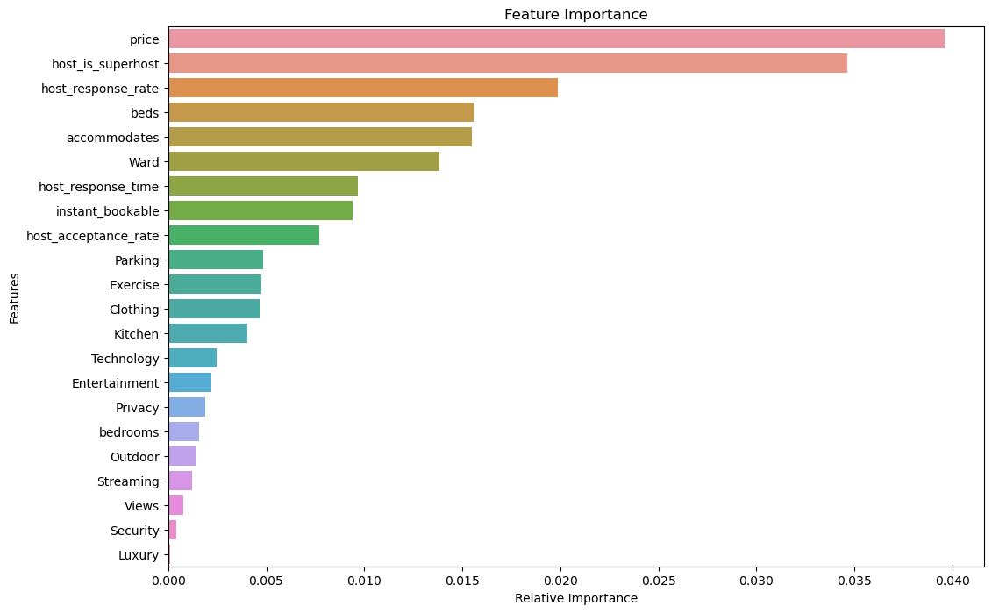
Variable Importance Plot

Slide 40
Interpretation of Results
05

Slide 41
Interpretation of Results
The Three algorithms that have performed relatively better than the bunch of models that were tested in this project are - Gradient Boosting Classifier, Decision Tree and Naive Bayes Classifier.
The Naive Bayes Classifier had the highest true negative rate and precision score
The Decision Tree Classifier had relatively high metrics with the smallest standard deviations
The Gradient Boost Classifier had the highest balanced accuracy, recall, and f1 score. It also had the highest negative predictive value, although the standard deviation was very high
To answer our SMART question, actionable factors influencing a listing’s rating include the listing price, the host’s response rate, the host’s response time, and amenities such as free parking, exercise and gym equipment, free washer and dryer, and extraordinary kitchen appliances.

Slide 42
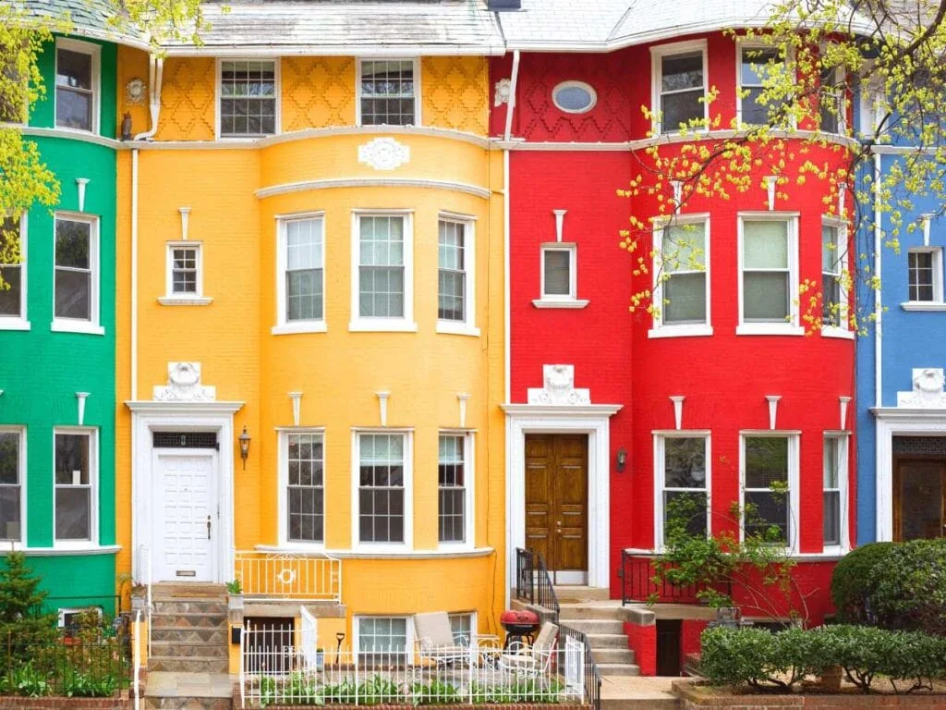
Interpretation of Results
Hosts who want to increase their ratings should focus on fast response times and providing adequate parking, laundry facilities, exercise equipment, and additional kitchen appliances, among others
Future contingencies for the project are:
Tuning Hyperparameters for the models to attempt to approve the metrics
Utilize Explainable AI libraries such as SHAP to gain a deeper understanding of our models
Using deep learning by employing multi layer perceptrons to see if the results are better.
Perform prediction on the variable price.
Image Reference: https://images.app.goo.gl/HHwszmxJEC4sjZSq6

Slide 43
References
Angelica Lo Duca (2021), https://towardsdatascience.com/how-to-write-a-scientific-paper-from-a-data-science-project-62d7101c9057
https://towardsdatascience.com/understanding-random-forest-58381e0602d2
Inside Airbnb. http://insideairbnb.com/washington-dc/
Owens, J. (2020). An Analysis of AirBnB in Washington, DC. https://medium.com/@jessie.owens2/an-analysis-of-airbnb-in-washington-dc-8013cfef7379

Slide 44
Thank you!

